Slide 1
COMBIVIS connect „Remote Maintenance“
Workshop ISM 2015
Zacharewicz / Meyer
V1.1_EN

Slide 2
Topics
1. Softwarearchitecture
2. COMBIVIS connect Domain / Control Center
3. COMBIVIS connect Runtime
4. General functions of COMBIVIS connect
7. Network security (Firewall)
5. User- and device management
6. VPN connection / serial connection
8. Network bridge / subnetwork

Slide 3
Software architecture
Topic

Slide 4
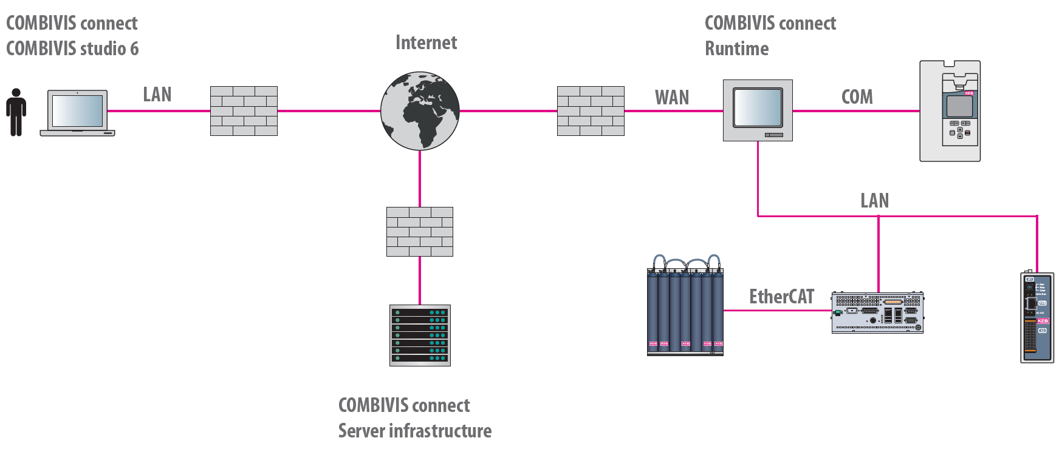
Software architecture (C6 Router)
COMBIVIS Control Center: Software application on the office PC
COMBIVIS Connect Runtime: Software componente on the remote PC/HMI
COMBIVIS Connect Cloud: distributed support infrastructure
COMBIVIS connect Control Center

Slide 5
COMBIVIS connect Control Center / Domain
Topic

Slide 6
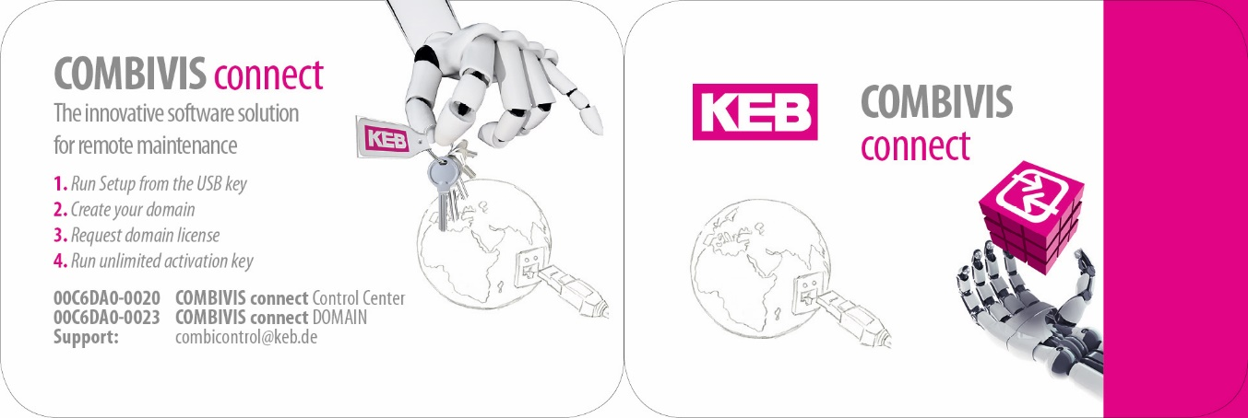
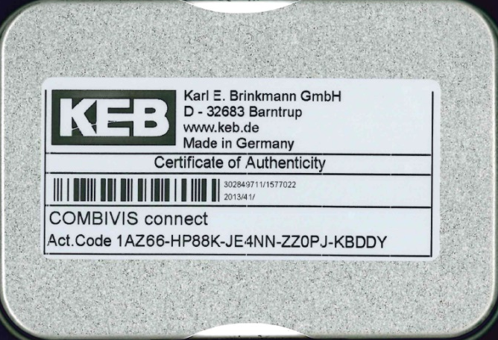
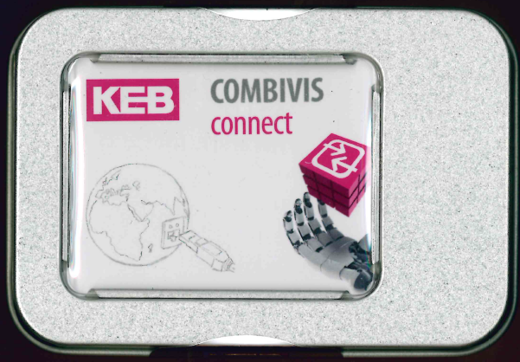
Activate connect domain
One-time, a license fee will be charged for the registration of the domain
With your order you will receive an USB key with the COMBIVIS connect software
Registration of COMBIVIS connect Domain

Slide 7
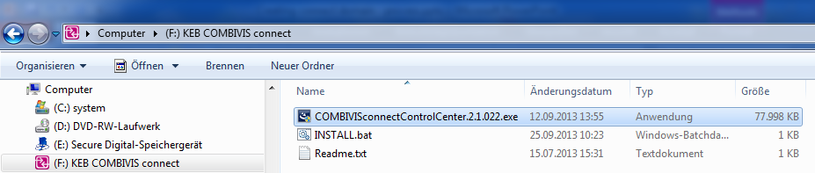
Run setup from USB KEY
Now run the setup from USB key
Hinweis:
An installation and use of the COMBIVIS connect Control Center software is allowed on several local PCs
A virtual network adapter and a virtual serial port are added on the local PC during the installation ➔ it is necessary for the VPN via Ethernet or serial connection
Notes:
Installations- Datei vom COMBIVIS Control Center
Die COMBIVIS Control Center Software kann auf mehrere lokale PCs installiert und genutzt werden, um eine Verbindung zu den Remote-Geräten herzustellen.
Ein virtueller Netzwerkadapter und eine virtuelle serielle Schnittstelle werden während der Installation den bereits vorhandenen Netzwerkadaptern des Remote-Gerätes hinzugefügt.
Sobald eine VPN-Verbindung aufgebaut wird, wird dem virtuellen Adapter des lokalen PCs automatisch eine freie IP-Adresse zugewiesen. Diese IP-Adresse befindet sich im gleichen Adressbereich des virtuellen Adapters oder der Netzwerkbrücke des Remote-PCs.

Slide 8
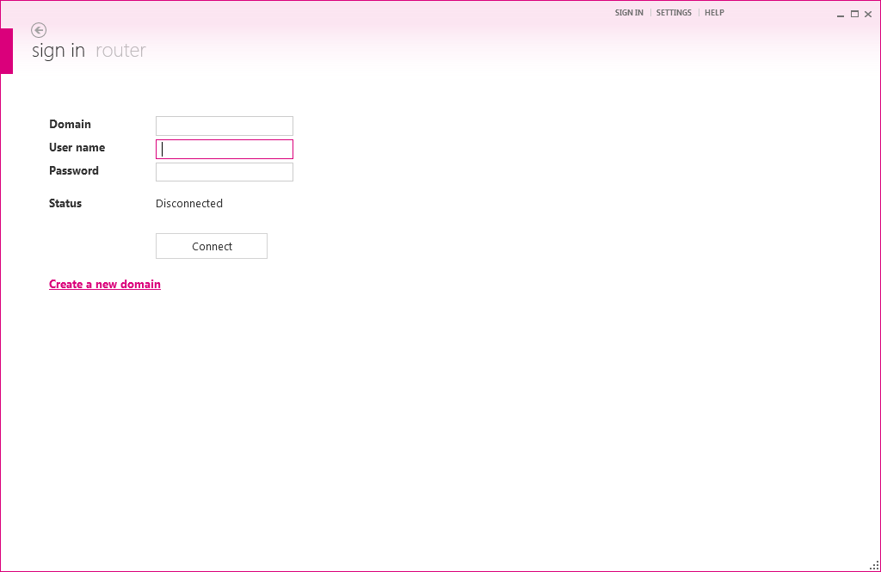
Create your domain 1/2
Create a new domain

Slide 9
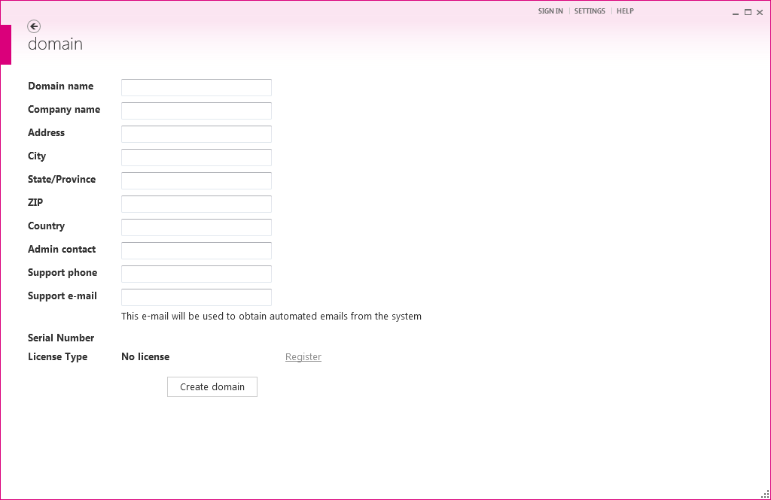
Create your domain 2/2
Fill in the domain properties

Slide 10
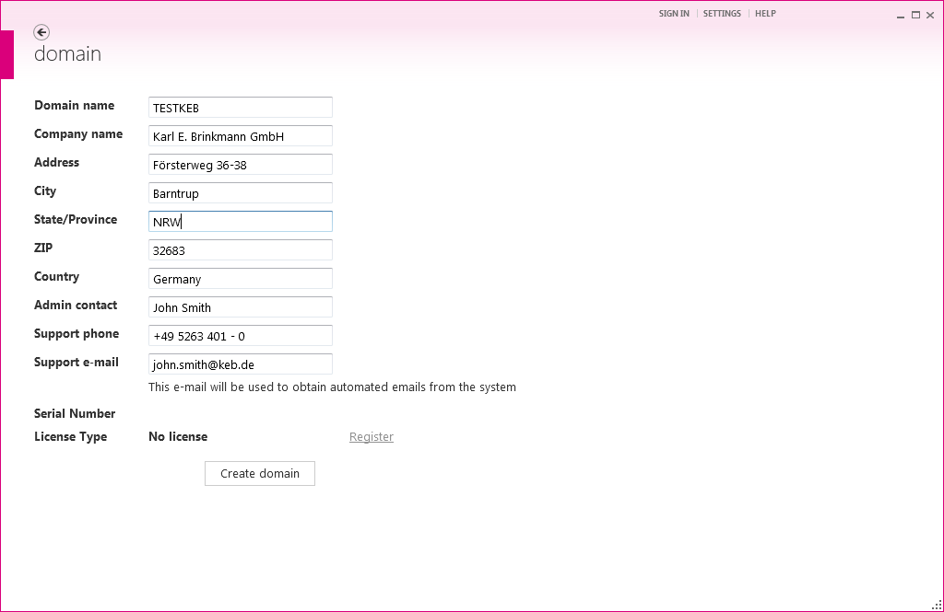
Request domain license 1/2
After filling in the domain properties, the domain must be requested (request is automatically sent)

Slide 11
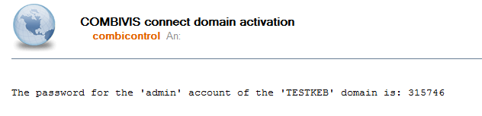
Request domain license 2/2
Recieve an email with the admin account details
Benutzername
Domain
Passwort

Slide 12
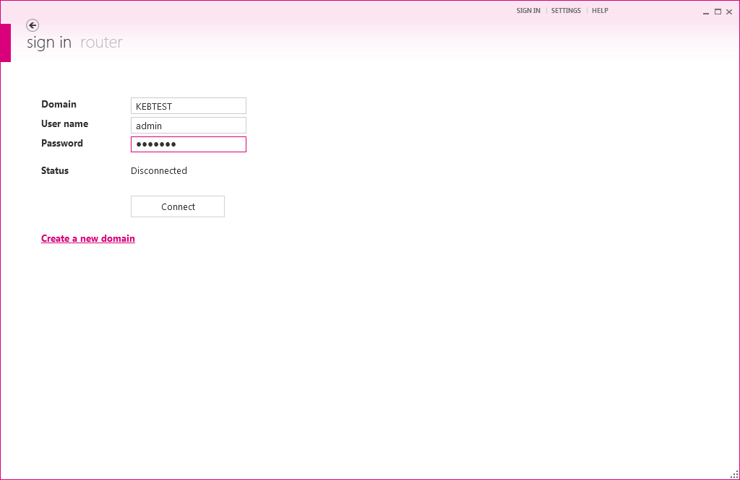
Run unlimited activation key 1/4
Log in with the forwarded admin account

Slide 13
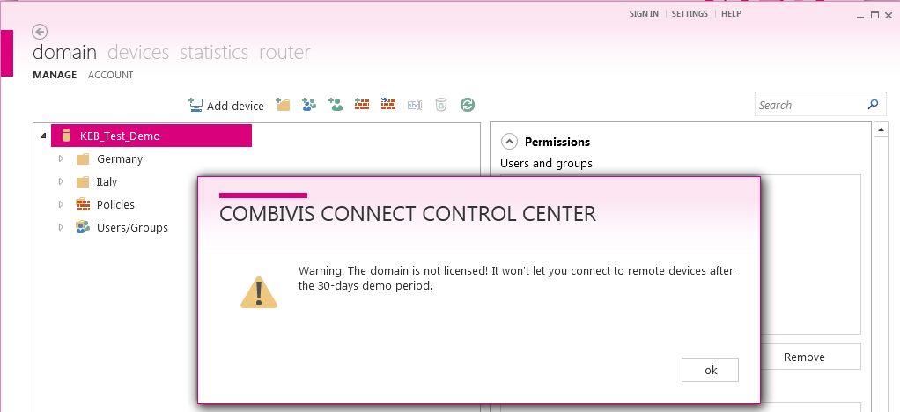
Run unlimited activation key 2/4
Now, the domain must be activated
Change to the „Domain Account“ view

Slide 14
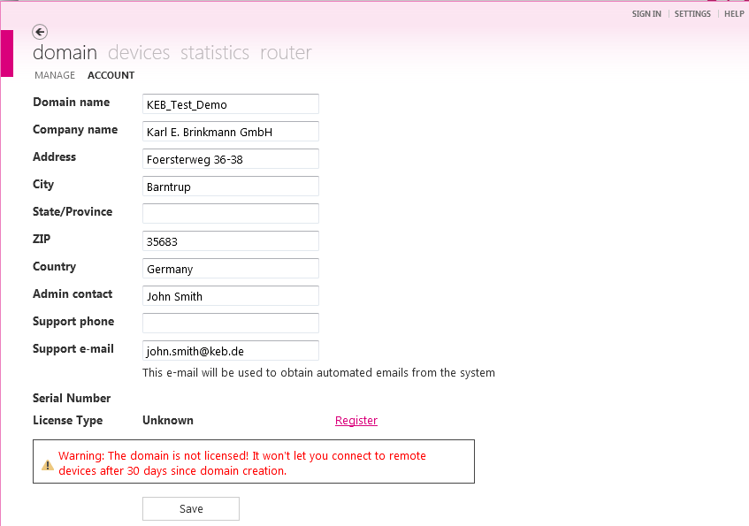
Run unlimited activation key 3/4
Register the domain

Slide 15
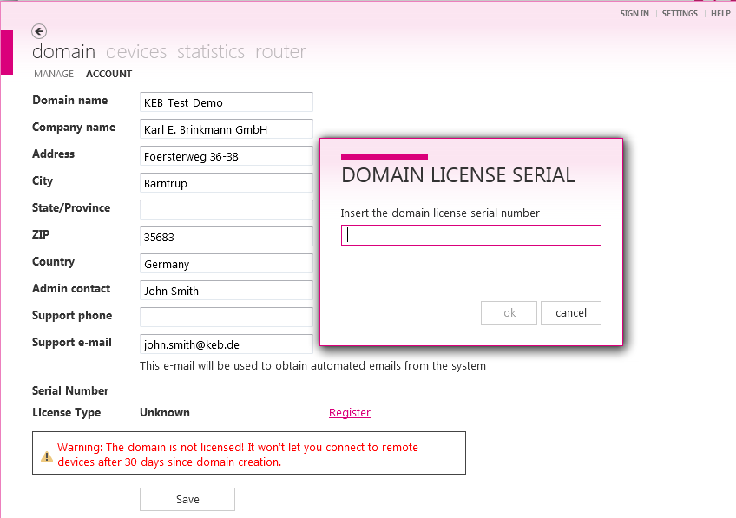
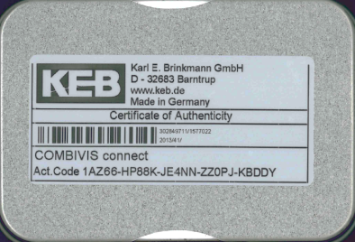
Run unlimited activation key 4/4
Enter the license serial number from nameplate of USB key box
After registration, the domain process is done

Slide 16
COMBIVIS connect Runtime
Topic

Slide 17
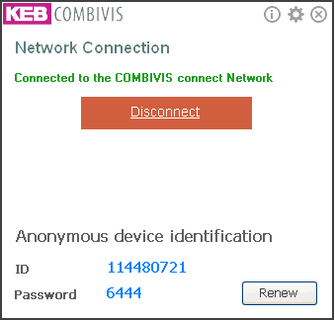
Licensing COMBIVIS connect runtime
To allow the remote access to the remote PCs/HMIs, the COMBIVIS connect runtime must be started
Push the button "Connect" to establish the connection to the server infrastructure
Inform the COMBIVIS connect administrator about the ID and the password

Slide 18
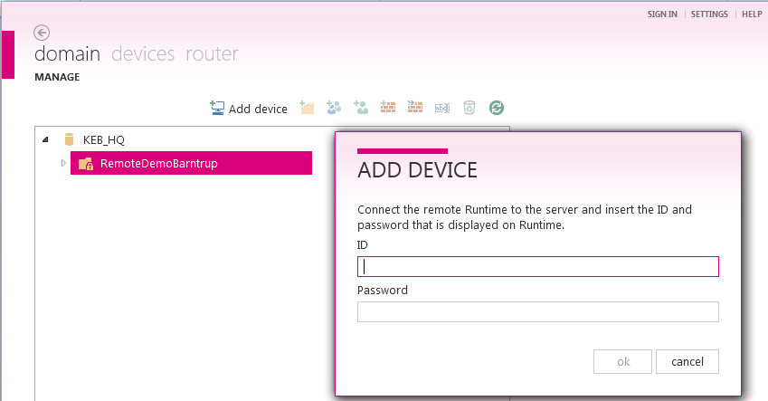
Add device to domain 1/3
Administrator or authorized users add remote PC/HMI in the corresponding folder of the domain
Administrator assigns permissions to selected users

Slide 19
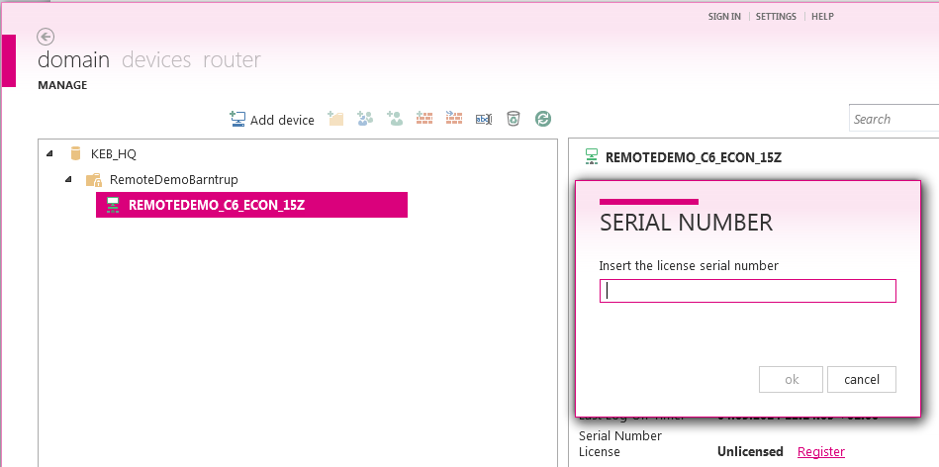
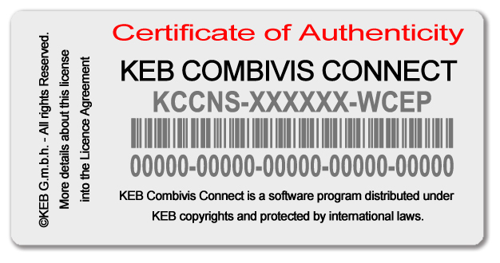
Add device to domain 2/3
The COMBIVIS connect runtime must be registered using the license number of device nameplate (PC/HMI)

Slide 20
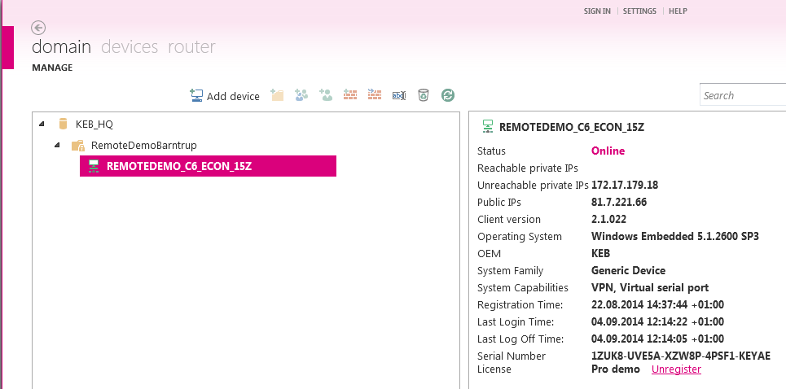
Add device to domain 3/3
Now, the device (PC/HMI) was added to your domain

Slide 21



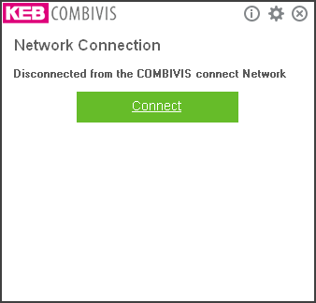
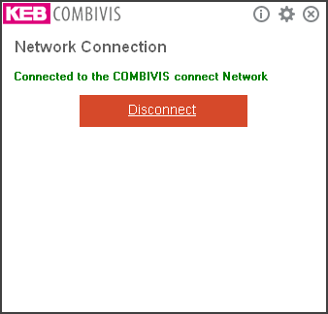
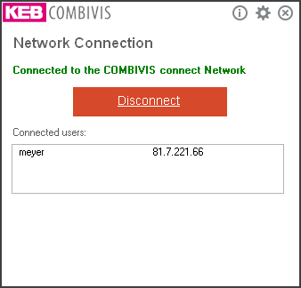
COMBIVIS connect Runtime
Identification of the different operation modes
You can find the icon in the taskbar
Notes:
It gives different operation modes of the COMBIVIS connect Runtime:
Icon grey:
The remote device is disconnected from the COMBIVIS connect network.
Icon pink:
The remote device is connected to the COMBIVIS connect network but no user has connected with this device.
Icon green:
The remote device is connected to the COMBIVIS connect network and one or more users have connected with this device.

Slide 22
General Functions of COMBIVIS connect
Topic

Slide 23
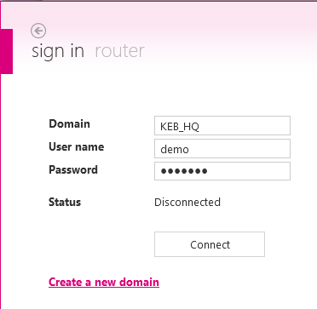
Connection with server infrastructure 1/2
Start COMBIVIS connect runtime and connect the remote PC to the server
Start COMBIVIS connect Control center ➔ connect the local PC with the server after entering of domain, user name and password

Slide 24
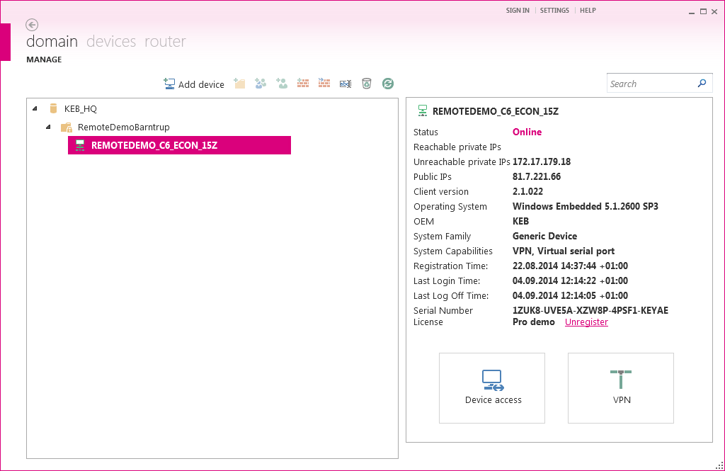
Connection with server infrastructure 2/2
Remote devices which are currently connected to the server are displayed under the register "Device“ (green marked)

Slide 25
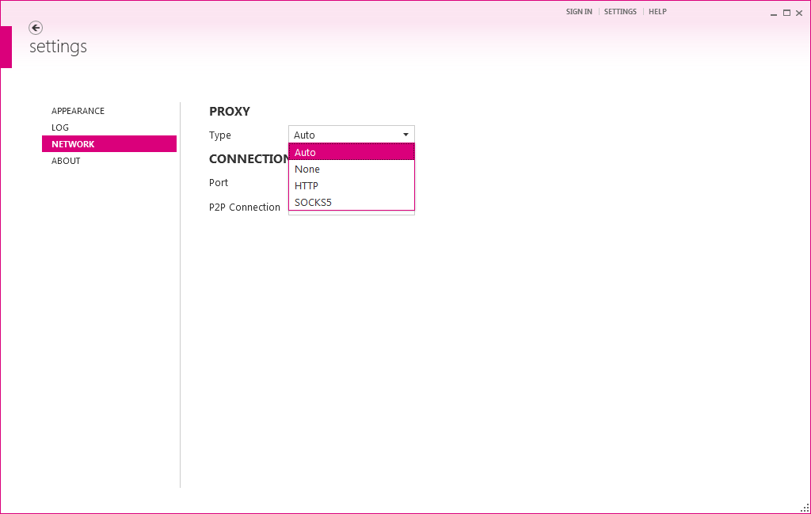
Network settings 1/3 (Proxy)
Proxy possibilities:
Auto: Use Internet-Explorer settings (IP address and port) (without user name and password)
HTTP, SOCKS5: Support authentication with user name and password
None: No Proxy is used for the connection

Slide 26
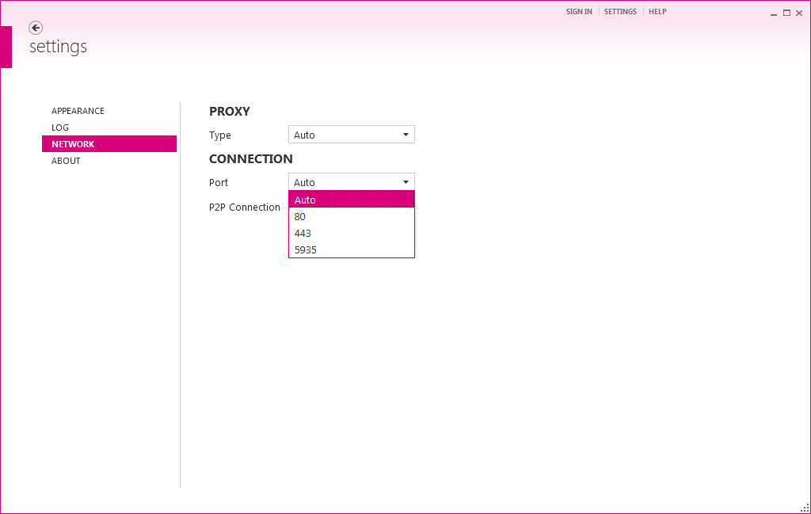
Network settings 2/3 (Port)
Port options for the connection between Control Center and infrastructure
Auto: Use the first available port (TCP or UDP) 443, 80, 5935.
80, 443, 5935: Use the adjusted port

Slide 27
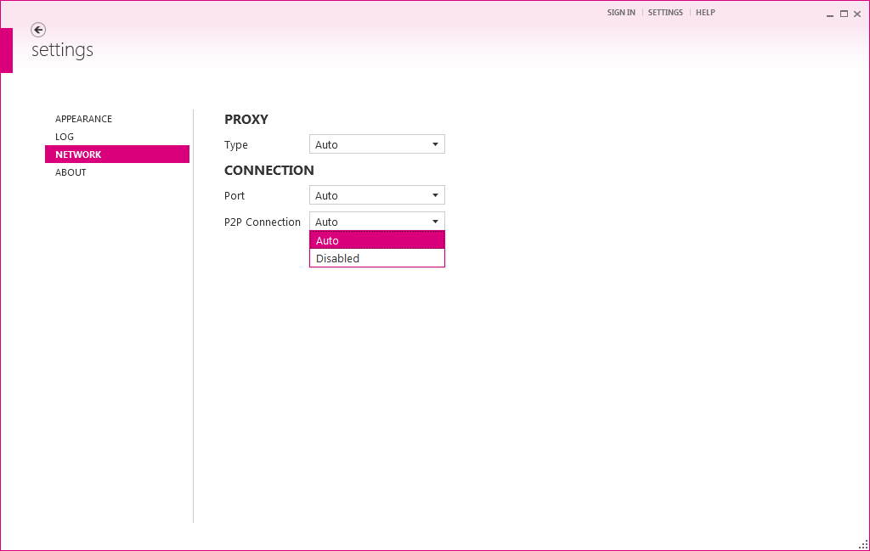
Network settings (Connectifity) 3/3
Peer-To-Peer connection options between Control Center and CV connect Runtime
Auto: If possible, the P2P is used to connect to the destination Runtime, otherwise the mirror server will used.
Disabled: Uses the connection via the mirror server without an attempt via P2P approach.

Slide 28
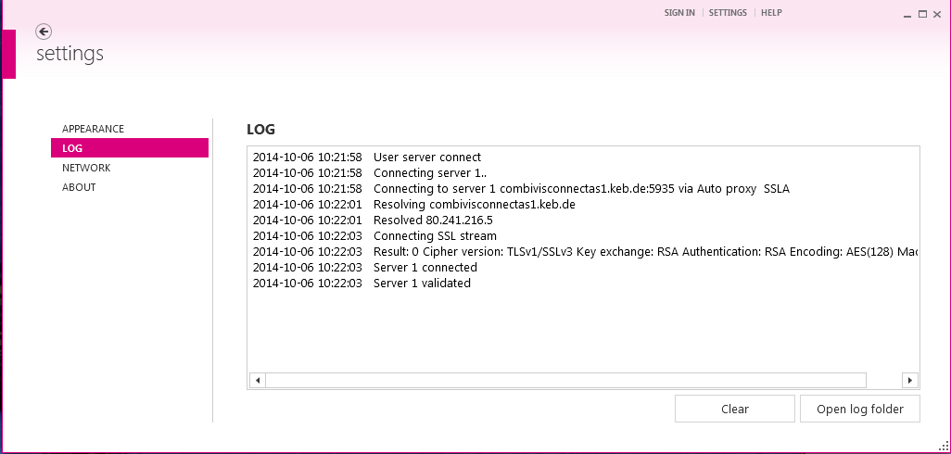
Log file of the server connection
The user can receive all important information about the intended connection in the Log file.
The Log-file consists the date, the time and the current status of the connection.

Slide 29
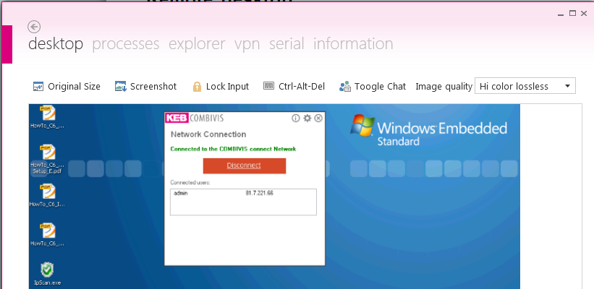
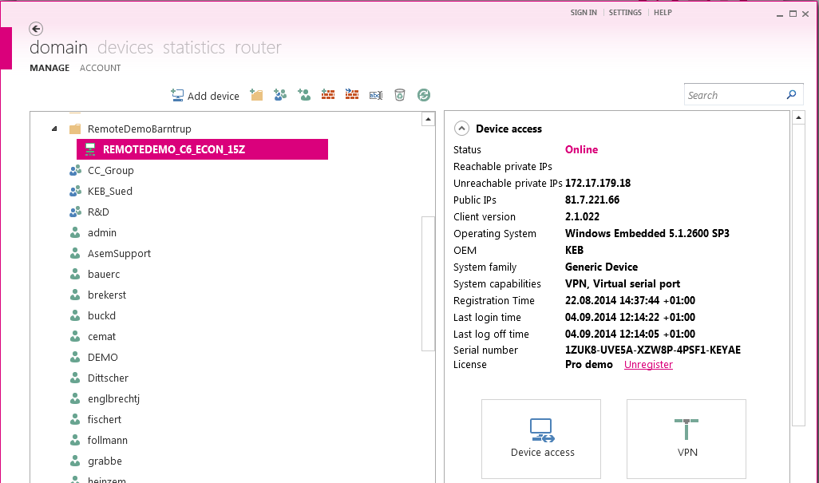
Remote desktop
Start the CVS Connect Runtime / CVS Connect Control Center and connect with the server infrastructure
Choose the corresponding remote PC/HMI
Call up the desktop of the remote PC/HMI about the „Remote Desktop“- button on your local PC ➔ remote control of the remote PC/HMI

Slide 30
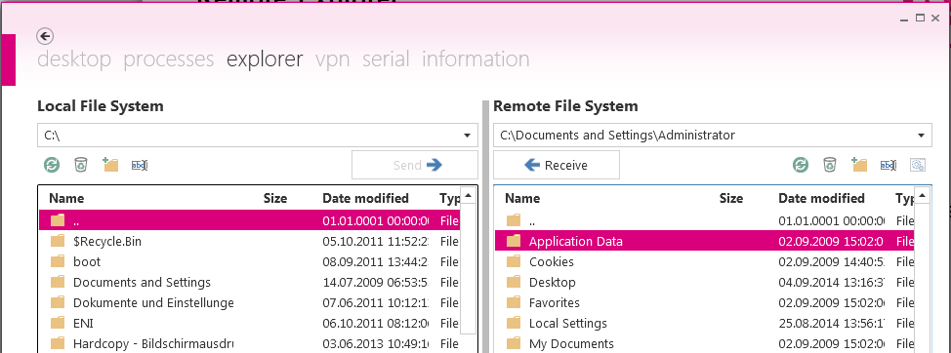
Remote explorer
Choose the function „Remote Explorer“
Enables the
creating folders as well as the deleting and renaming of folders and files
file exchange between local PC and remote PC ➔ similar to Windows Explorer

Slide 31
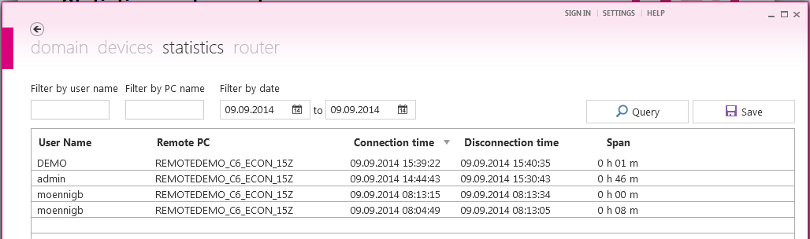
Statistics and reports
Under the function statistics and reports, the administrator receives the following information:
which user logs in
on which remote PC the user has logged in
at what time has a user logged in or logged out
how long was the user logged in
Notes:
Protocols of connection
Server-Infrastruktur keeps a minutes (protocol) about all connections which were made on a certain domain.
The information is available to the domain administrator for the check and supervision.

Slide 32
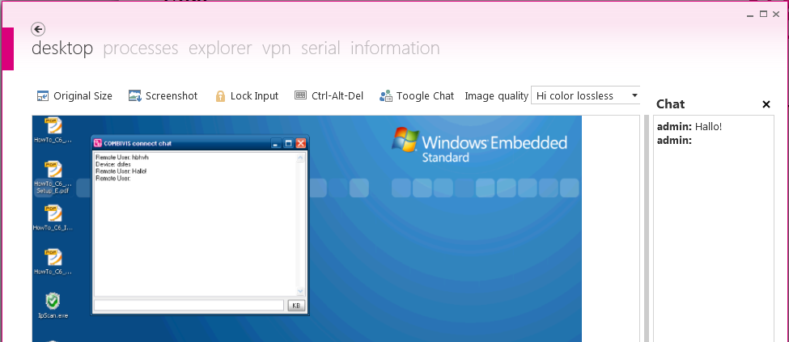
Chat
Enables the written conversation with the user at the remote PC
Messages are sent to the desktop of the remote PC ➔ User of the remote PC can reply about real keyboard or software keyboard

Slide 33
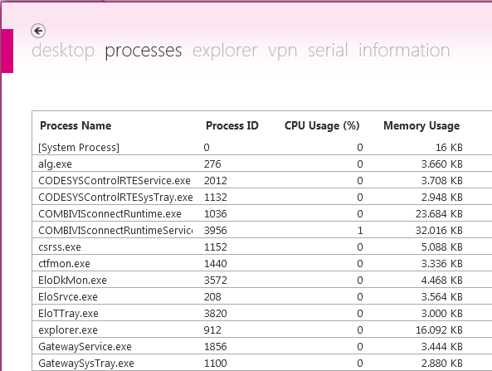
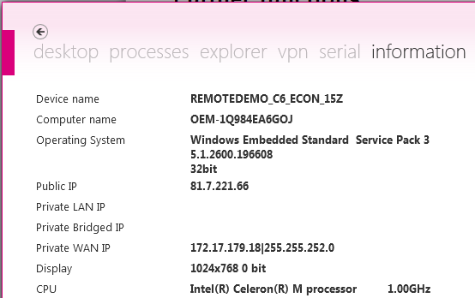
Further functions
Reboot ➔ Reboot the remote PC (COMBIVIS Connect Runtime starts automatically)
Remote Process-Manager ➔ Process management (similar to Windows process management)
System-Information ➔ Device name, Computer name, Version of operating system, IP addresses, etc.
1
1
2
2

Slide 34
User- and Device-Management
Topic

Slide 35
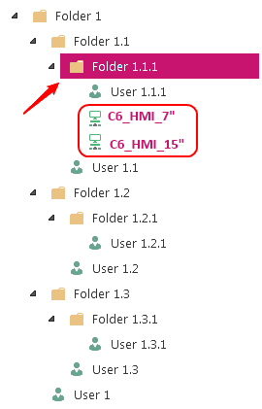
User management 1/5
Only the administrator has the access to the user management and he can
add, edit and delete the corresponding users
allocate an initial password for the new user
add new user groups and assign corresponding users to them
Groups/Users can be assigned the folders and the devices within the folder inherits these permissions

Slide 36
User management 2/5
Group/User permissions can be also assigned directly to the devices
Rules which were assigned to sub-folders or devices, cancel higher folder rules
Permissions can be changed for certain user of a group, even if the user belongs to a group with other permissions

Slide 37
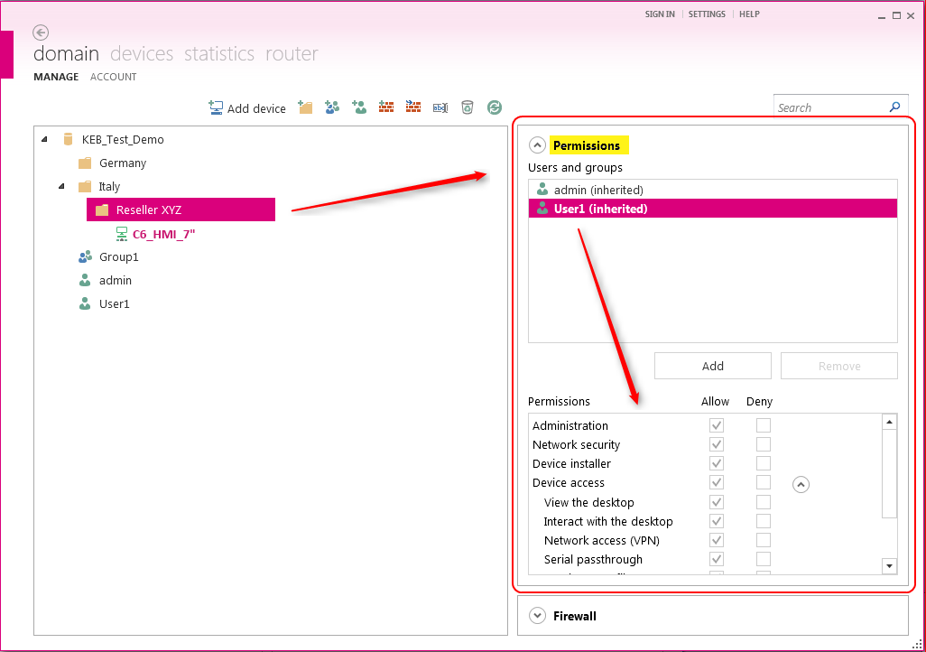
User management 3/5
Allocation of permissions for groups/users in the form of profiles
The defined access rules always refer to a folder or device

Slide 38
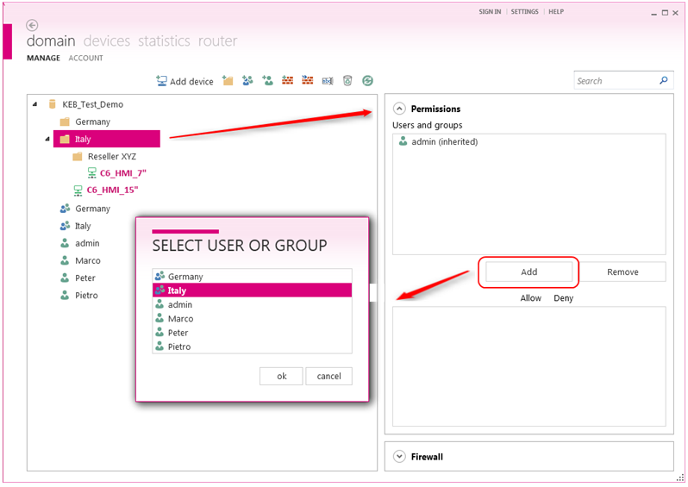
User management 4/5
To assign permissions, the following procedures have to be executed:
Choice of the folder or device
Allocation of group/user to a folder or a selected device

Slide 39
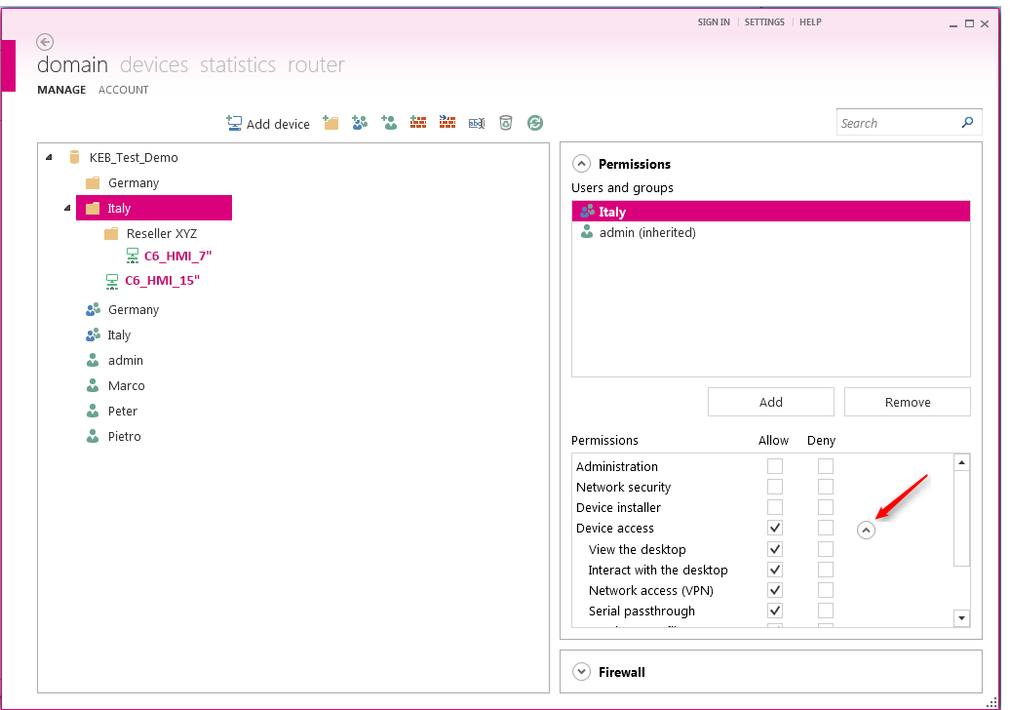
User management 5/5
Allocation of the profiles to every group/user who is assigned to the folder or device

Slide 40
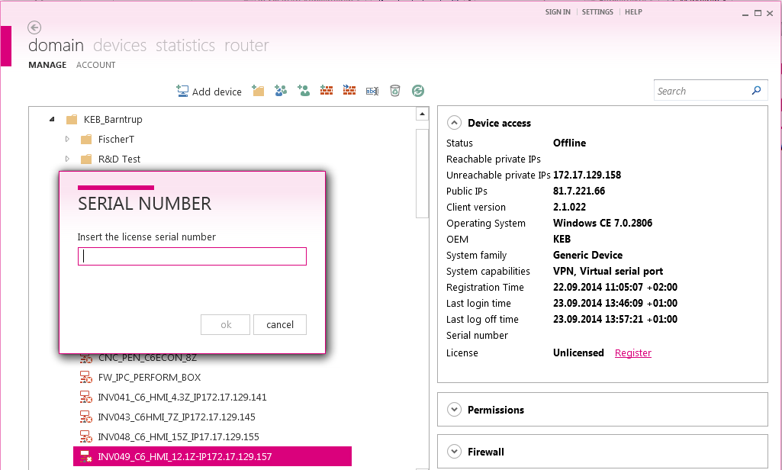
Device management 1/2
After a device was added to the domain or to the folder using its ID and password, it can be
assigned to a available folder or a new folder
unlocked by entering the requested license key

Slide 41
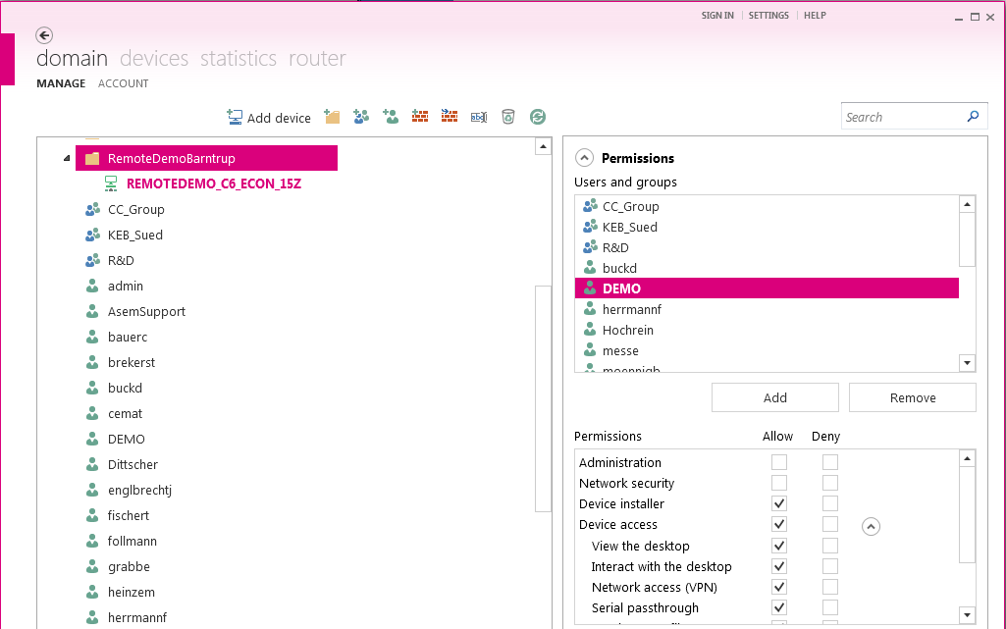
Device management 2/2
The folders can be assigned several users or user groups
All users can be allowed or denied specified permissions

Slide 42
VPN connection / Serial connection
Topic

Slide 43
VPN connection 1/7
VPN = virtual private network on a public infrastructure
only communication partners who belong to the network can communicate and exchange data with each other
the COMBIVIS connect server infrastructure corresponds to highest safety standards ➔ SSL / TLS protocol
therefore, the connection is access- and manipulation-proof (Protection against attacks such as „Man in the middle attack, Brute force attack, Password theft …)
VPN-partners can establish a connection through an insecure network, without an increased risk
enables the KEB device search with COMBIVIS 6 via Ethernet

Slide 44
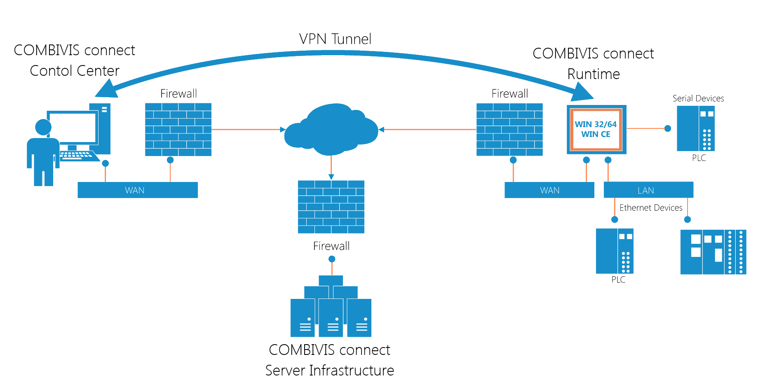
VPN connection 2/7
Notes:
COMBIVIS Control Center authenticates based on domain name, user name and password.
The COMBIVIS connect Server Infrastructure enables the Control Center user to connect to the remote Runtime system registered in the domain.
The COMBIVIS connect Runtime authenticates with COMBIVIS connect Server Infrastructure using a unique certificate
After the Runtime component is connected and authenticated, the Control Center can initiate an end-to-end secure connection. When a direct peer-to-peer connection is not possible, the connection can be forwarded by the server infrastructure.
Control Center and Runtime connect to the COMBIVIS connect Server Infrastructure using a secure connection (SSL/TLS)
The outgoing connection is recognized safe and approved by means of firewall rules
Usable ports are: 80, 443, 5935
If UDP ports are available, these should be used to improve the performance
Messages are not decoded by COMBIVIS Connect Cloud because the SSL connection "end-to-end" is secured.

Slide 45
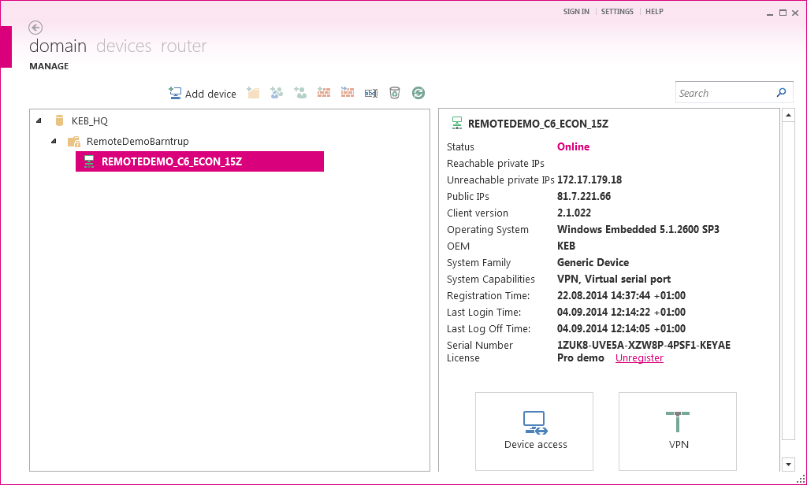
VPN connection 3/7
Start the Connect Runtime / Connect Control Center and connect the Server
Choose the desired remote PC and open the VPN-window via VPN button

Slide 46
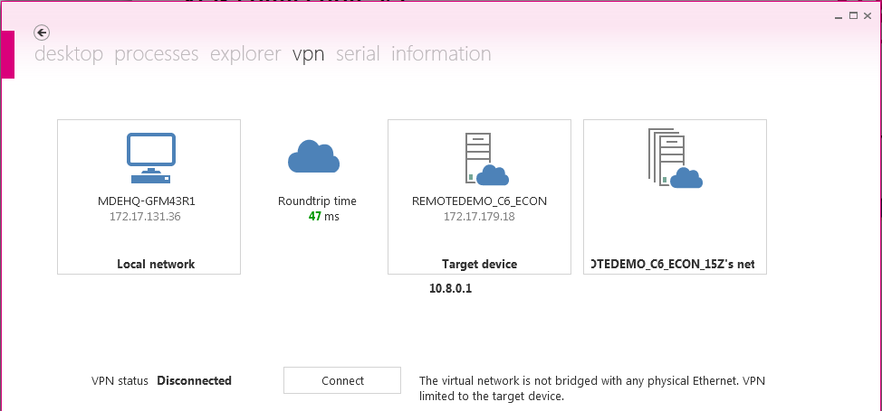
VPN connection 4/7
Start the VPN connection via the button "connect”

Slide 47
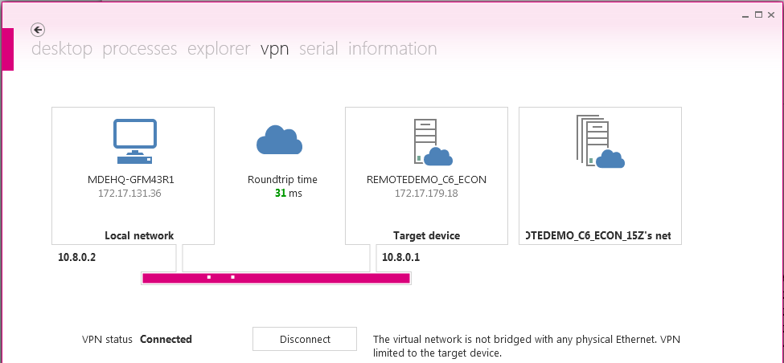
VPN connection 5/7
After successful connection, the connection is displayed in magenta
Remote PC has the IP-address 10.8.01 (virtual interface) ➔ automatically assigned during the COMBIVIS connect runtime installation
Control Center PC receives a free IP-address (e.g. 10.8.0.2) in the same IP-area

Slide 48
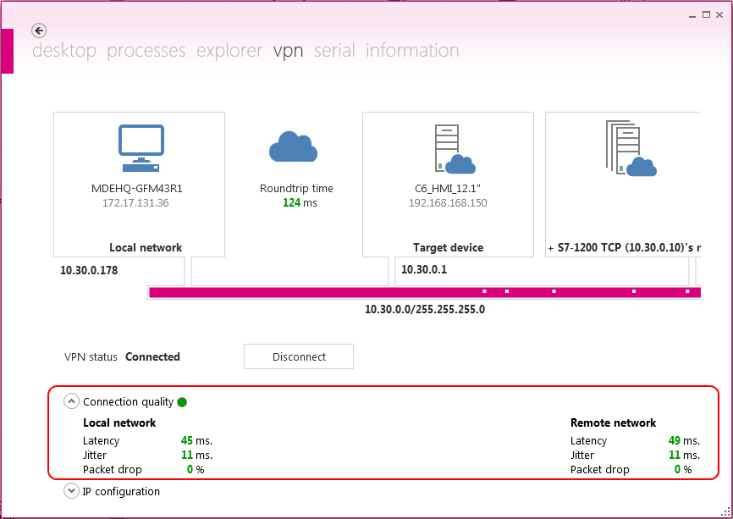
VPN connection 6/7
Display of connection quality for
Local network
Remote network (Subnetwork)

Slide 49
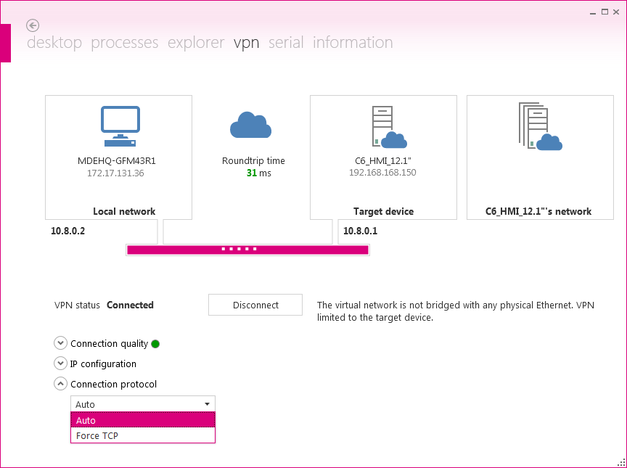

VPN-connection 7/7
Communication protocol options of the VPN-connection
Auto: If it is not blocked for other reasons, the use of the UDP protocol is prefered for VPN connection, otherwise the TCP protocol is used
Force TCP: Use the TCP protocol for the VPN connection
UDP packets may be filtered or penalised in some network infrastructures (e.g. Firewall).
Set the parameter schown above to „Force TCP“.

Slide 50
Serial Passthrough 1/4
on local PC, a virtual serial interface for the serial passthrough mode was established during the installation of COMBIVIS connect Control Center
serial remote access to remote devices through the physical serial port of the remote PC ➔ COM interface is selectable
serial communication is possible via RS232 or RS485 (RS485 at the C6-IPC is only possible in conjunction of a converter)
supports the passage of the serial data stream to remote serial device interface both as half- as well as full-duplex connection
enables the KEB device search with COMBIVIS 6 via Ethernet

Slide 51
Serial Passthrough 2/4
Start the Connect Runtime / Connect Control Center and connect the Server
Establish a VPN connection between local PC and remote PC
Call up the serial passthrough mode via "Serial" function

Slide 52
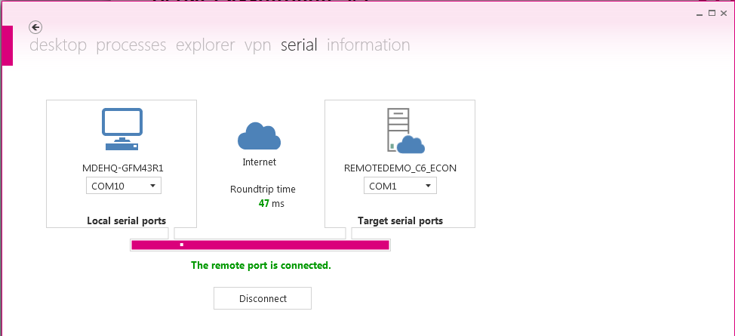
Serial Passthrough 3/4
Select the physical serial interface of the remote PC
The virtual COM-Port number of the local PC is entered by the user during the installation of COMBIVIS connect
Activate the serial data communication via the VPN tunnel with the button “connect”

Slide 53
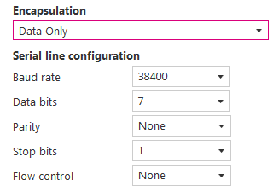
Serial Passthrough 4/4
There are three different setting possibilities for data transfer, interface configuration and handshake signals:
Data only:
This setting transmits only data.
It requires the manual setting of the serial communication interface parameters.
Data + Port configuration: (easiest setting)
This setting transmits data and serial interface configuration.
The serial interface will be automatically configured by the system.
Data + Port configuration + Data signals:
This setting transmits data, serial interface configuration and control signals.
Some serial protocols of automation devices are very sensitive to latency, and the remote serial communication could not work, even in the presence of very good connection times.

Slide 54
Firewall
Topic

Slide 55
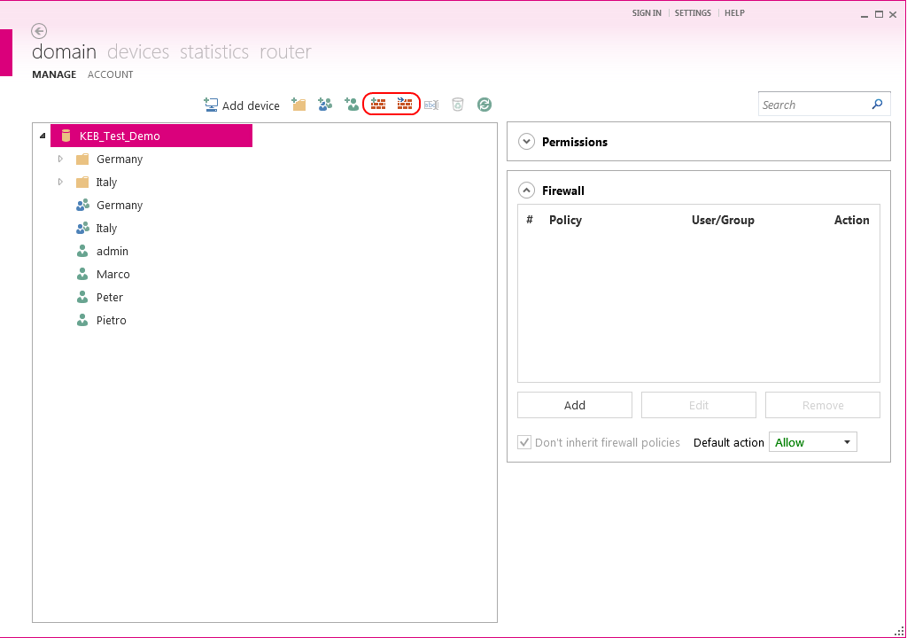
Firewall - General
Integrated Firewall makes definition and application of rules possible for the
dertermination other security levels
limitation of the data traffic on the VPN channel
The configuration method corresponds the procedure at conventional firewall systems
The addition of policies (guidelines) takes place about the both upper Firewall icons

Slide 56


Firewall – Import of policies (guidelines)
By clicking the import icon , a list of available policies is shown
Confirm the selection of the desired policy by clicking the "OK" button
The policy is inserted in the folder structure in dependent on the selected folder

Slide 57

Firewall – Personalised definition of policies 1/3
Mark a folder in which the policy is created
Then click on the button to define the rule
Give the policy a name

Slide 58


Firewall – Personalised definition of policies 2/3
By addition, a rule is inserted in the definition of the policy
The VPN of COMBIVIS connect supports the virtualisation of the datalink level whereby the integrated firewall enables the definition of policies
The list „Ethernet-Type“ is a collection of all usual protocols which are used on Ethernet level

Slide 59


Firewall – Personalised definition of policies 3/3
If "IP" is selected as an Ethernet type, the included IP address, the IP protocol and the IP port must be specified
With every step, the window „Firewall“ dynamically adapts itself on basis of the made selection

Slide 60

Firewall – Applying the policies (guidelines) 1/6
Usage of the defined policies takes place on folder level but also at the level of individual devices
The policies / rules, which should be accordingly applied, can be added to the area "firewall"

Slide 61
Firewall – Applying the policies (guidelines) 2/6
The default action for the domain is set to „Allow“ at the beginning
If no firewall policies / rules have been added, so all data packets are passed through without verification

Slide 62


Firewall – Applying the policies (guidelines) 3/6
There is a difference in the definition of policies between
negative logic ➔ default action = Allow / policy = Deny
positive logic ➔ default action = Deny / policy = Allow
negative Logik
positive Logik
Bezug auf Aktion der Richtlinien
Bezug auf Aktion der Richtlinien

Slide 63


Firewall – Applying the policies (guidelines) 4/6
Negative logic ➔ only the denied packages by the policy are blocked
Setting the Default action on "Allow”
Set the action within the policy on “Deny”

Slide 64


Firewall – Applying the policies (guidelines) 5/6
Positive logic ➔ only the allowed packages by the policy are passed through
Setting the Default action on “Deny”
Set the action within the policy on “Allow”

Slide 65


Firewall – Applying the policies (guidelines) 6/6
Applied policies can be inherited on subfolders and its contained devices.
If the inheritance chain is not interrupted (CheckBox not marked), the default action is specified by a higher-level folder
The Firewall area is always a summary of both inherited and explicitly applied policies for each selected device or folder
“Standardaktion” vom übergeordneten Ordner vererbt
“Standardaktion” nicht vom übergeordneten Ordner vererbt

Slide 66


Firewall – Example to the protocol filter 1/2
Import a pre-defined policy and their usage for a device ➔ independent of the user and the IP address of this device
Select a domain and then click the "Import Policy" button
Mark the desired policy in the list and import this with "OK“
Afterwards, select the device to which the policy shall be applied

Slide 67


Firewall – Example to the protocol filter 2/2
The VPN connection with the sub-network, which is connected to the selected device, shall only allow the use of "CoDeSys" protocol for programming the PLC
Set the action of the selected policy on „Allow“
Set the default action on „Deny“
Mark the check box to not inherit the action from the higher-level folder

Slide 68



Firewall – Example for inserting the IP filter
Now, the passage of the packages shall be further limited by means of an IP filter ➔ data traffic is only allowed for specific IP addresses
Adding a rule to the imported policy
Create a IP filter by input the IP details for this rule
Change of the policy is immediately effective at all folders/devices where it is applied

Slide 69




Firewall – Example for inserting the user filter
Now, the previously applied filters "protocol" and "IP" shall only become active if the users belong to a certain group ➔ user filter = allocation option in the policy
Select a device to which the policy should be applied
Mark the protocol of the policy in the Firewall area and click the button "Edit”
Select the user or user group from the drop-box and take over these

Slide 70
Network bridge / Subnetwork
Topic

Slide 71








Structure sub-network with C6 Router
Local PC
C6 Router
COMBIVIS connect Control Center
COMBIVIS connect Runtime
WAN
IP: 172.17.128.255
WAN
virtual Interface
IP:192.168.210.xxx
Bridge with LAN
IP:192.168.210.20
Ethernet
Server Infrastructure
RS 232
Ethernet
IP:192.168.210.141
IP:192.168.210.142
Notes:
Example with connections via Ethernet and serial by using the C6 HMI
In this example we use the C6 HMI as remote device which is connected with the Internet over the Ethernet-Port (LAN2).
A network bridge is created with the Ethernet-Port (LAN1) and one gets a separate sub-network as automation network with the IP address range (e.g. 192.168.210.xxx).
Since two Ethernet ports are available, the Internet access and the sub-network use separated Ethernet ports.
Two F5 devices are connected to the separate sub-network via Ethernet.
In addition, we can see a serial communication between a further F5 inverter and the C6 HMI.

Slide 72


Internet connection 1/2
Call up and adjust the settings of the Modem connection (Mobile connection)

Slide 73

Internet connection 2/2
Call up the settings for the network connections
Adjust the Ethernet-Port (WAN) for the Internet access (only, if you don’t use the mobile connection)

Slide 74

Sub-network (local automation network)
Select the configuration point Ethernet adapter (LAN) to assign the IP address of the sub-network (automation network)

Slide 75

Structure sub-network with C6 HMI (HMI-Panel)
Local PC
C6 HMI
COMBIVIS connect Control Center
COMBIVIS connect Runtime
WAN
IP: 172.17.128.255
LAN2
virtual Interface
IP:192.168.210.xxx
Bridge with LAN1
IP:192.168.210.20
Ethernet
Server Infrastructure
RS 232
Ethernet
IP:192.168.210.141
IP:192.168.210.142
Notes:
Example with connections via Ethernet and serial by using the C6 HMI
In this example we use the C6 HMI as remote device which is connected with the Internet over the Ethernet-Port (LAN2).
A network bridge is created with the Ethernet-Port (LAN1) and one gets a separate sub-network as automation network with the IP address range (e.g. 192.168.210.xxx).
Since two Ethernet ports are available, the Internet access and the sub-network use separated Ethernet ports.
Two F5 devices are connected to the separate sub-network via Ethernet.
In addition, we can see a serial communication between a further F5 inverter and the C6 HMI.

Slide 76



Network bridge 1/3
Call up the settings for the network connections
Adjust the Ethernet-Port (LAN2) for the Internet access (see the example)

Slide 77



Network bridge 2/3
Creating a network bridge
Open the COMBIVIS connect Runtime and push the setting icon
Select the Ethernet adapter (LAN1) to bridge this with the virtual adapter
Now, push the button “Create bridge”
After the execution, confirm the message “The bridge has been created”
After reboot, the VPN adapter is currently bridged
Notes:
Creating a network bridge in the menue “VPN”
First, you have to open the COMBIVIS connect Runtime.

Slide 78




Network bridge 3/3
Configure the network bridge settings in the menue “VPN IPs”
Enter and add the IP-address of the network bridge
Push the Button “Apply” to save the IP settings and reboot the C6HMI
After the reboot, you can look at the settings of the network bridge
Notes:
Configure the network bridge settings in the menue “VPN IPs”

Slide 79

Thank you for
your attention!

